Slide 1


Project 2.0
Supervised Learning

Slide 2


SkiResorts.Ai
Problem
Solution
Methodology
Results
Future Work

Slide 3
Problem
Skiing is ever more popular
Improving resorts is expensive and competition is fierce
Investments must be targeted
Notes:
With cheap flights, improvements in transport networks and continued investments skiers have access to more resorts than ever
Resort owners need to think carefully about where to invest to maximise their returns as well as balancing the benefits of price changes against the risks.

Slide 4
Solution
Use Artificial Intelligence!
Machine learning is the future of ski resort management
Notes:
With the power of machine learning you can approach the problem with all the data at your fingertips

Slide 5
Solution
Apply algorithm to determine whether a new feature will improve customer ratings
Invest with confidence

Slide 6
Methodology - Data
Database of every ski resort in the world
Extensive list of features:
Location
Elevation (min, max, change)
Piste Lengths
Piste Breakdown (Blue, Red, Black)
Ski Lifts
Ski Pass Costs
Notes:
Utilises an extensive set of data including 3009 resorts

Slide 7
Methodology - Target
Each ski resort is given a rating based on customer reviews and extensive market research:
“Excellent”
“Good”
“Poor”
Notes:
Utilises an extensive set of data

Slide 8
Methodology - Classifier
A Random Forest Classifier has been implemented to predict ratings
Almost 800 hyperparameter combinations
Cross-validation
Hyper parameters selected based on average accuracy of 90%
Deviations from default:
Minimum Samples Split: 4
Max Features: log2
Notes:
('n_estimators', 100) ('max_depth', None) ('min_samples_split', 4) ('max_features', 'log2') ('class_weight', None) ('ccp_alpha', 0.0)

Slide 9
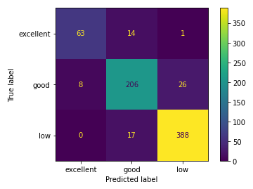
Methodology - Evaluation
Crucial not to over-estimate resort rating
Maximise precision, i.e. reduce False Positives of excellent or good ratings
Notes:
Otherwise owners may invest underestimate the investment necessary
Before evaluation, 97% precision when predicting Excellent resorts

Slide 10
Results
Thresholds adjusted to improve precision
Results:
85% Accuracy
100% Precision – Excellent Rating
Other approaches:
ROC* curve – 0.97
Probability calibration – no improvement
* Receiver Operating Characteristic
Notes:
Accuracy of course suffers

Slide 11
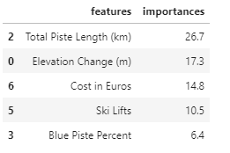
Results
Importance of Features:

Slide 12
Results – User Guide
Insert resort details (location, ski piste length etc.)
Programme provides rating
Insert desired changes
Programme provides new ratings
Use to identify most effective changes and compare against rival resorts

Slide 13
Future Work
Include alternative classifiers
Test with different datasets
Automate training and evaluation process
Create user interface
Notes:
Classifiers – adaboost, ensemble logistic, ensemble svm
Datasets – drop costs. Instantiate with KNN or regression classifier

